Slide 1


GREEN THUMB
~Green Thumb’s Grow-Your-Own Kit
‘Gardening Made Easy’

Slide 2
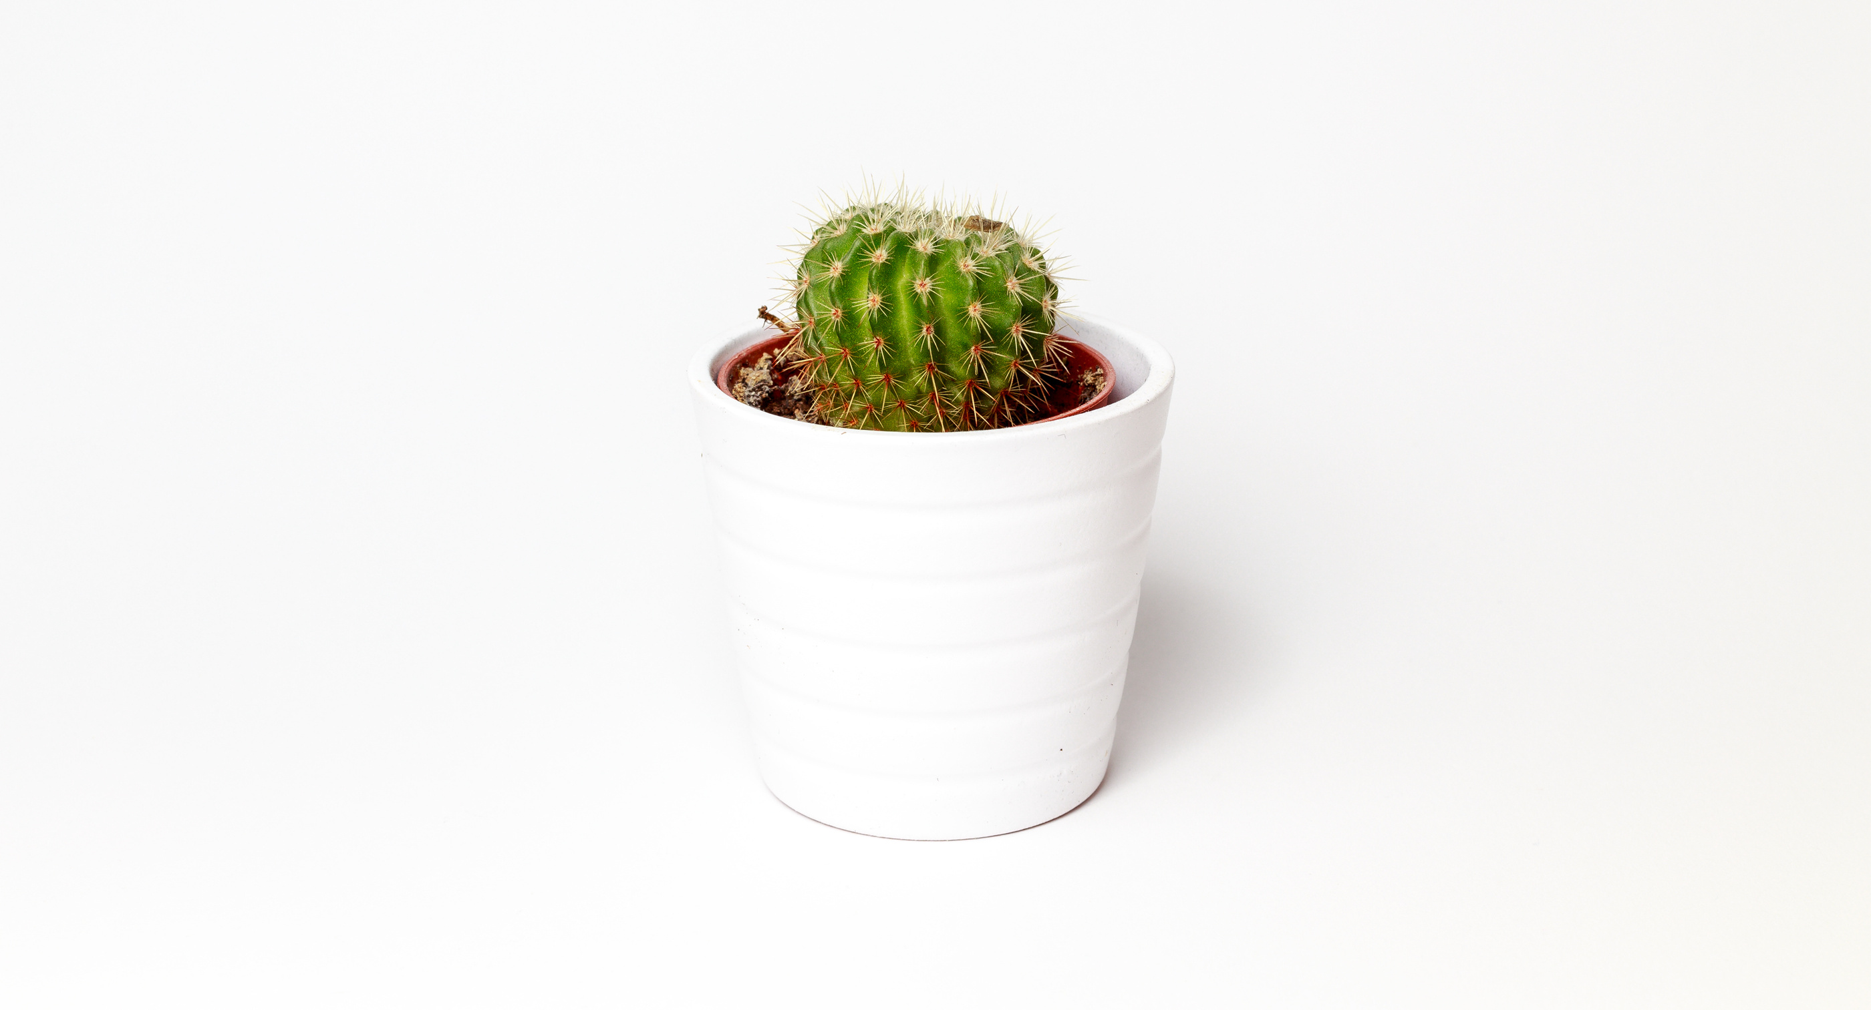

The problem:
01.
Limited gardening knowledge
Lack of time for garden maintenance
Insufficient space for gardening
Difficulty selecting suitable plants
Frustration with trial-and-error gardening
02.
Urban dwellers
Busy professionals
Beginners in gardening
Environmentally conscious individuals
Those seeking stress relief through gardening
03.
Carefully selected, high-quality plants
Pre-measured soil and fertilizers
Step-by-step instructions
Space-saving, stylish planters
Ongoing customer support
04.
E-commerce platform for online orders
Digital instruction manuals and tutorials
Mobile app for gardening tips and reminders
Online community forum for customer support
Data analytics for customer feedback and improvement

Slide 3
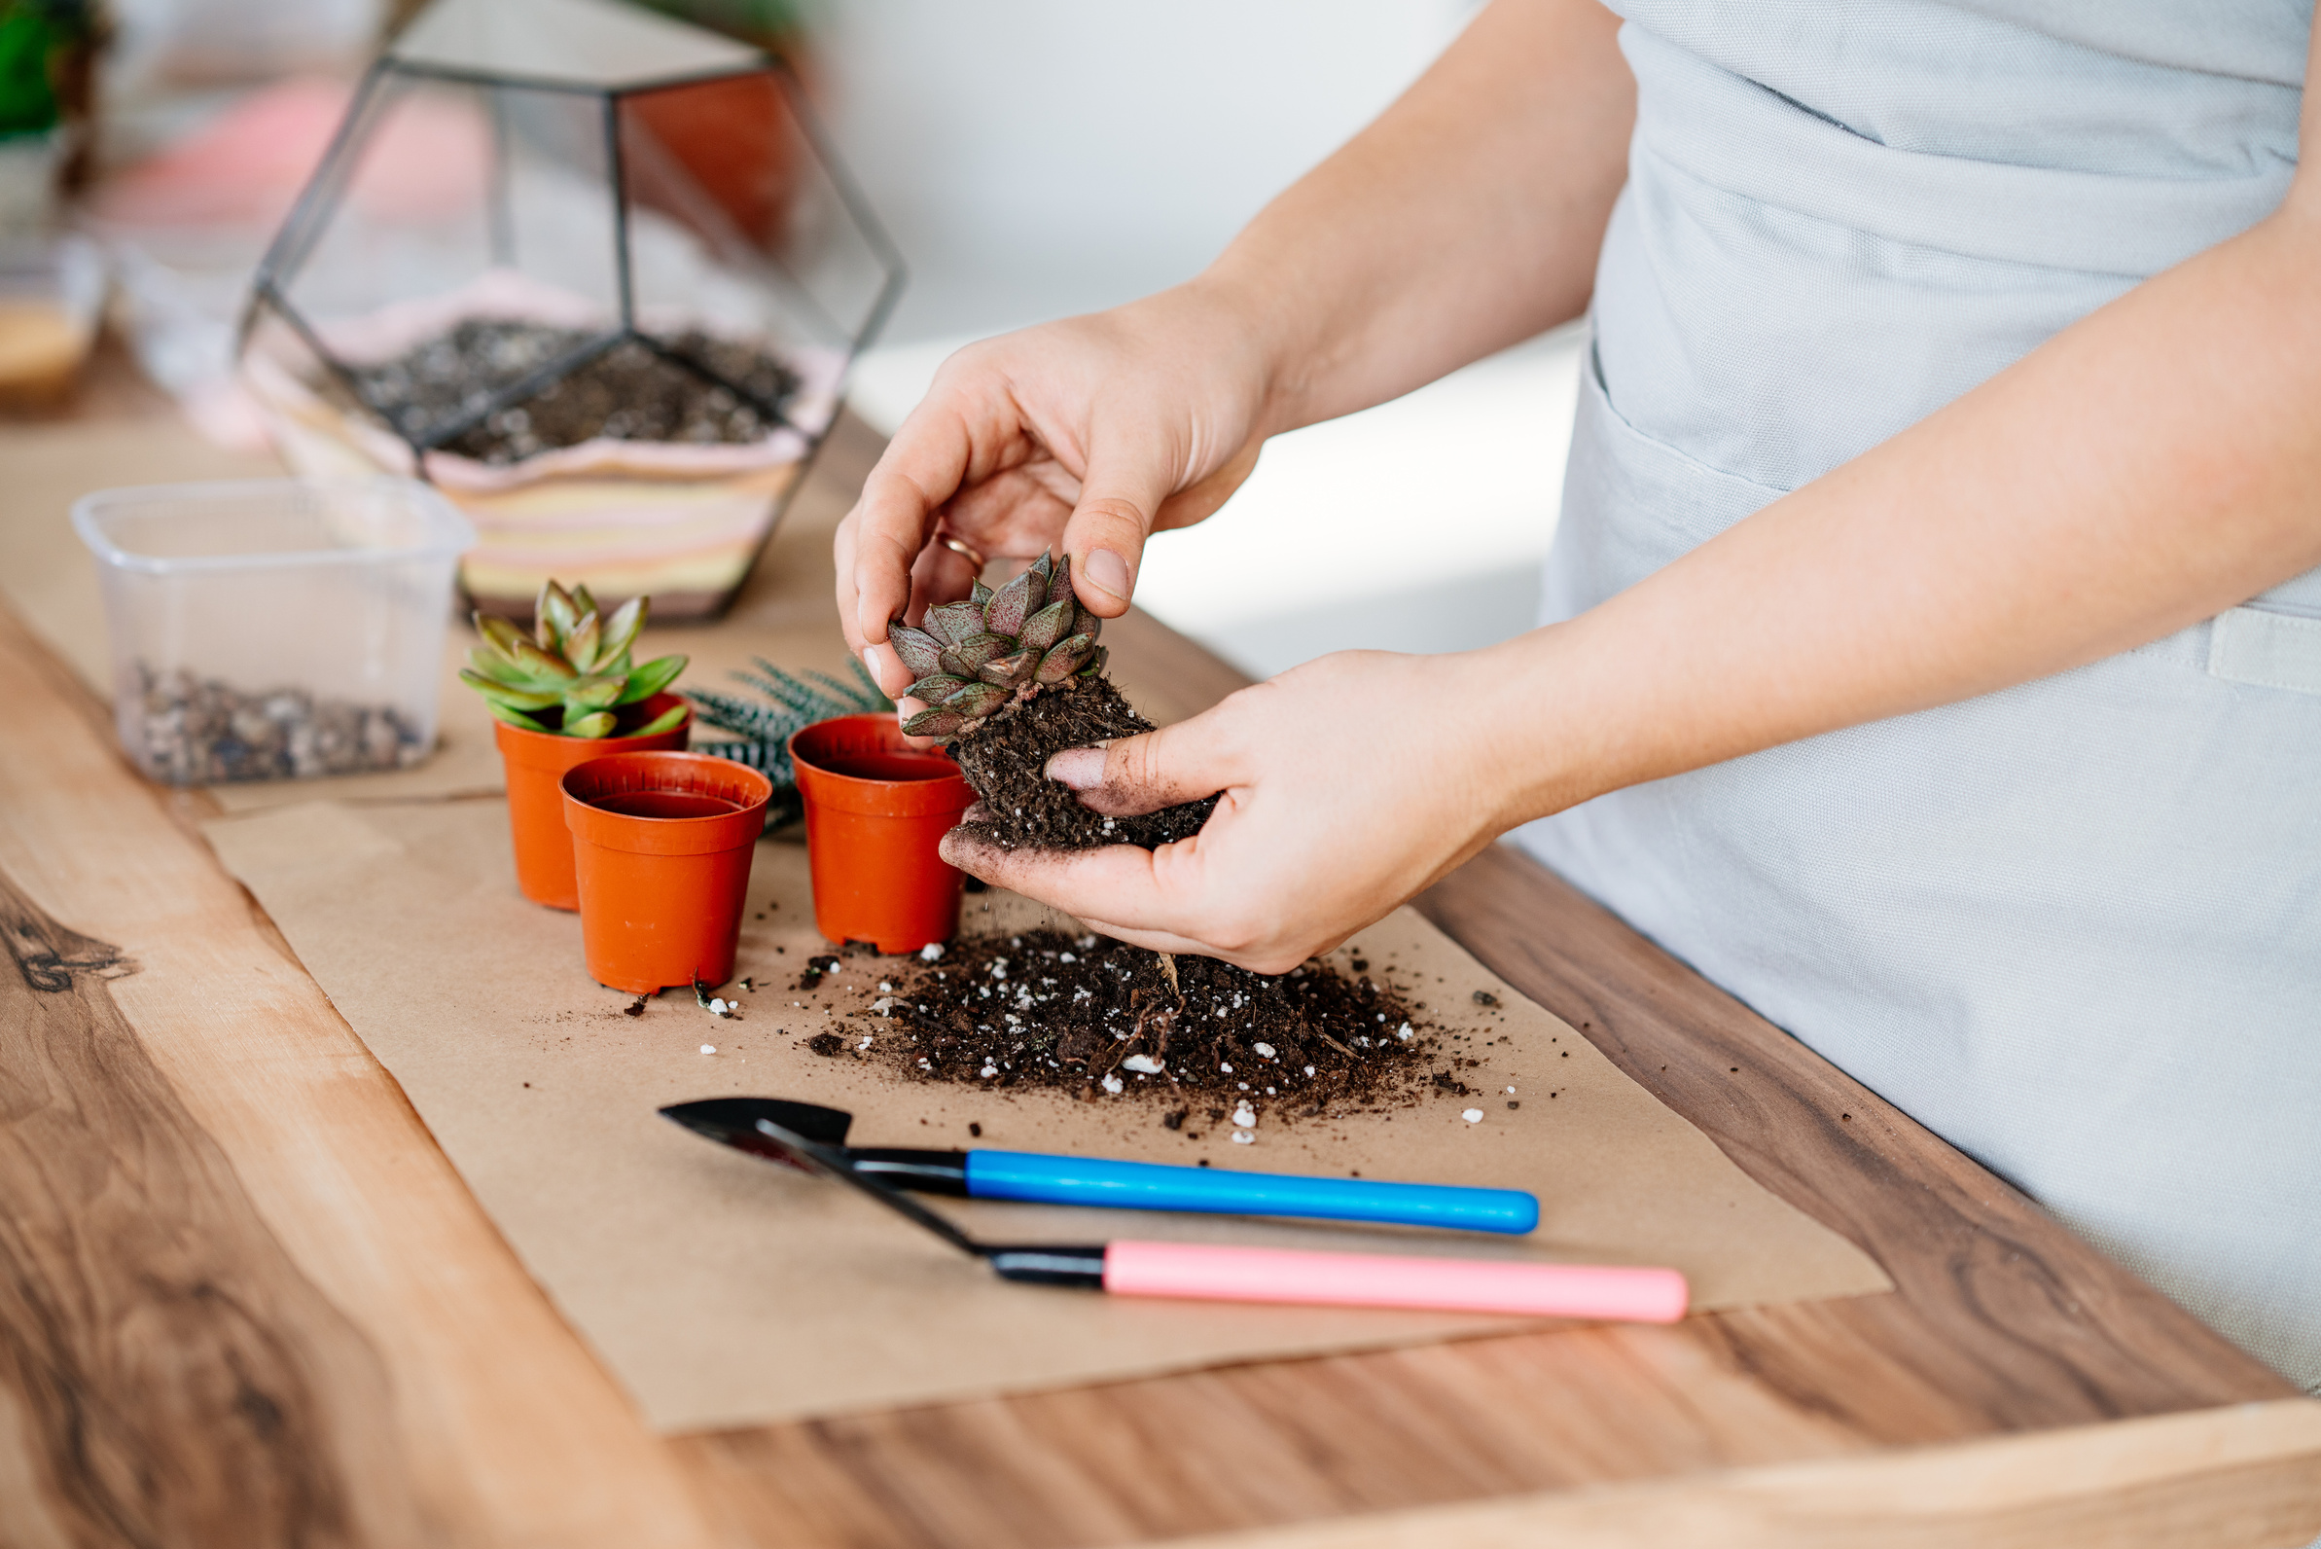


What Green Thumb Does:
Provides an all-in-one, eco-friendly gardening kit.
Offers personalized gardening guidance.
Includes sustainable materials and practices.
Facilitates community engagement and support.
How Green Thumb Solves the Problem:
Space-efficient design for urban gardens.
Expert guidance for beginners.
Environmental sustainability features.
Cost-effective and accessible.
Community support for motivation.
Why Green Thumb is Compelling:
Unique blend of sustainability and accessibility.
Comprehensive solution for urban gardeners.
Scalable and adaptable design.
Potential for significant environmental impact.
Strong market demand and growth potential.

Slide 4
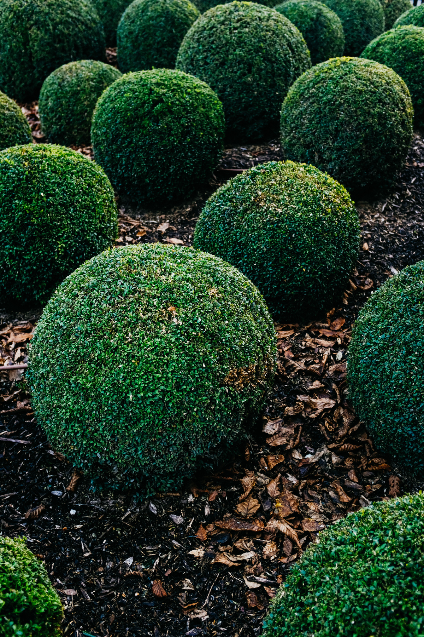
"Green Thumb empowers urban gardeners to cultivate a sustainable, efficient, and thriving gardening experience, providing a comprehensive, eco-friendly, and accessible solution that combines innovative products, expert guidance, and community support."
Environmental Benefits:
1. Reduced water waste (up to 50%)
2. Minimized chemical use
3. Increased carbon sequestration
4. Promotion of biodiversity
Economic Benefits:
1. Cost savings (up to 30%)
2. Increased crop yields
3. Extended growing season
4. Potential for commercial opportunities
Social Benefits:
1. Enhanced community engagement
2. Improved mental health and well-being
3. Increased food security
4. Education and skill-building

Slide 5
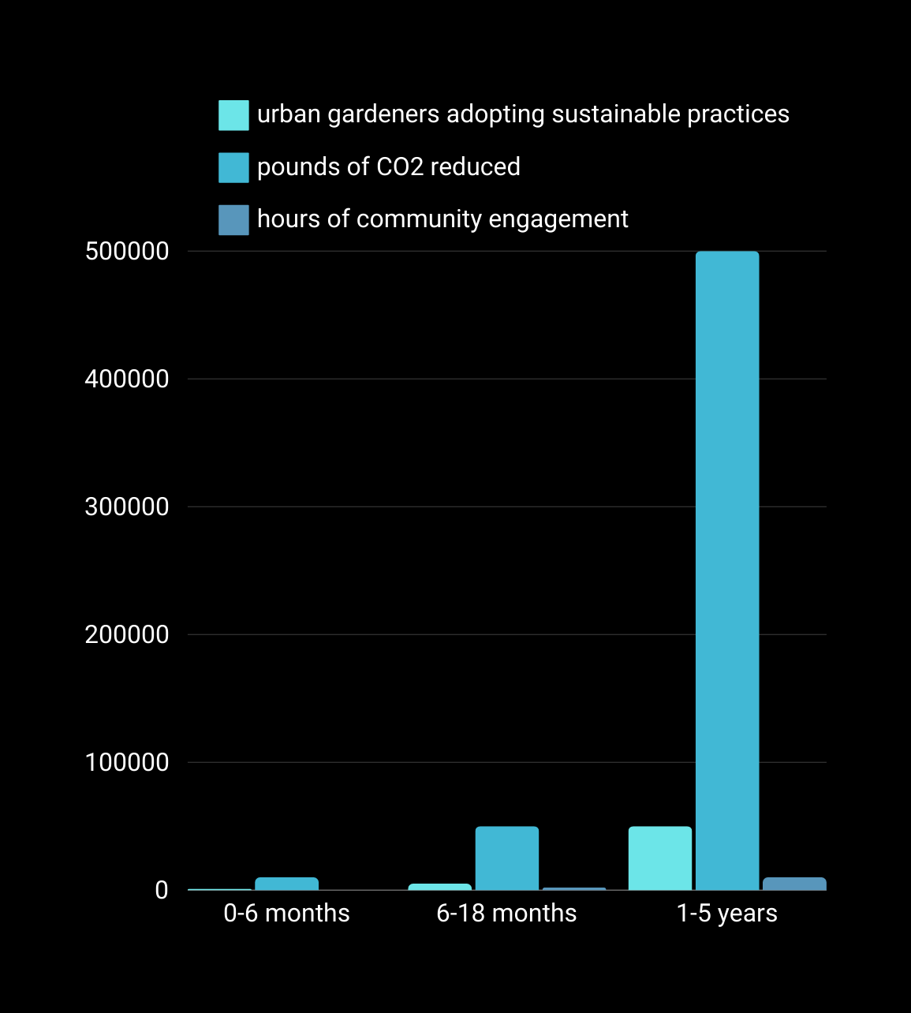
IMPACT

Slide 6
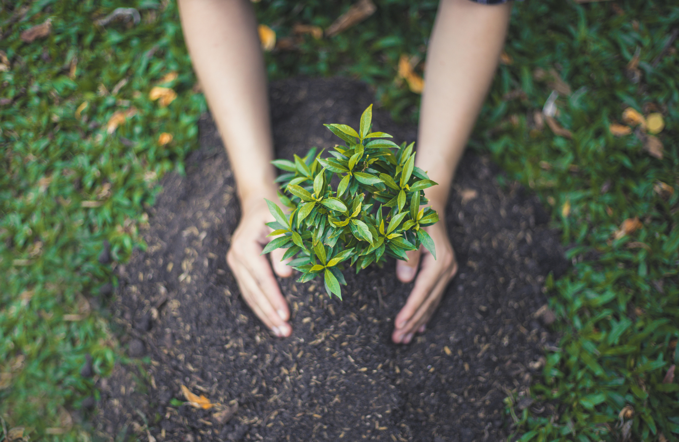
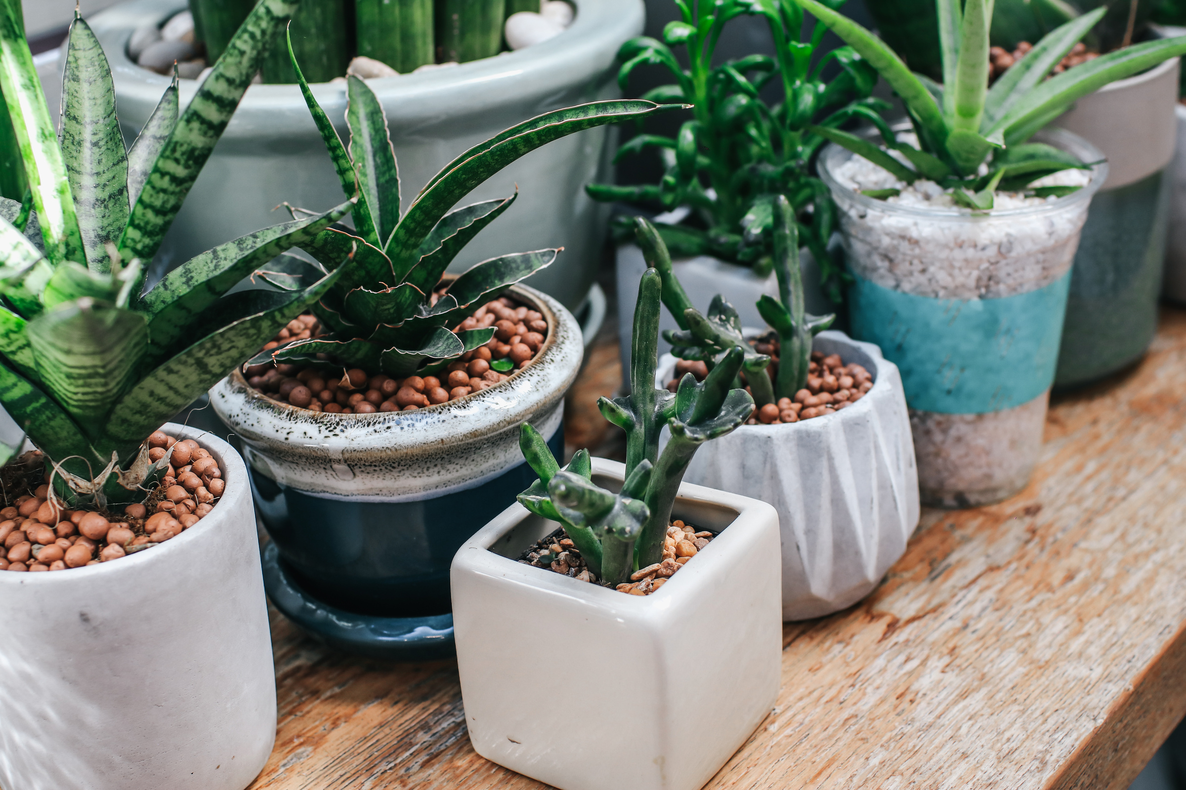
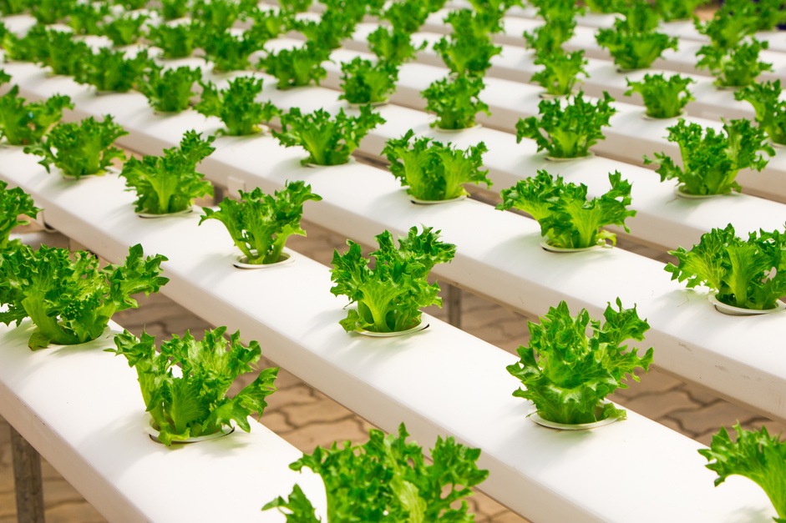
Total Addressable Market (TAM):
The total potential market size for urban gardening products and services.
Estimation: $10 billion (global urban gardening market size)
Serviceable Addressable Market (SAM):
The portion of TAM that Green Thumb can realistically target based on its resources and focus.
Estimation: $500 million (urban gardening market size in the United States)
Target Market:
Definition: The specific portion of SAM that Green Thumb aims to capture.
Estimation: $200 million (urban gardening market size in major US cities)
Primary Research Data:
1. Surveys: 500 urban gardeners, 100 commercial growers
2. Focus groups: 5 sessions with urban gardeners, 2 sessions with commercial growers
3. Interviews: 20 urban gardening experts, 10 commercial growers

Slide 7
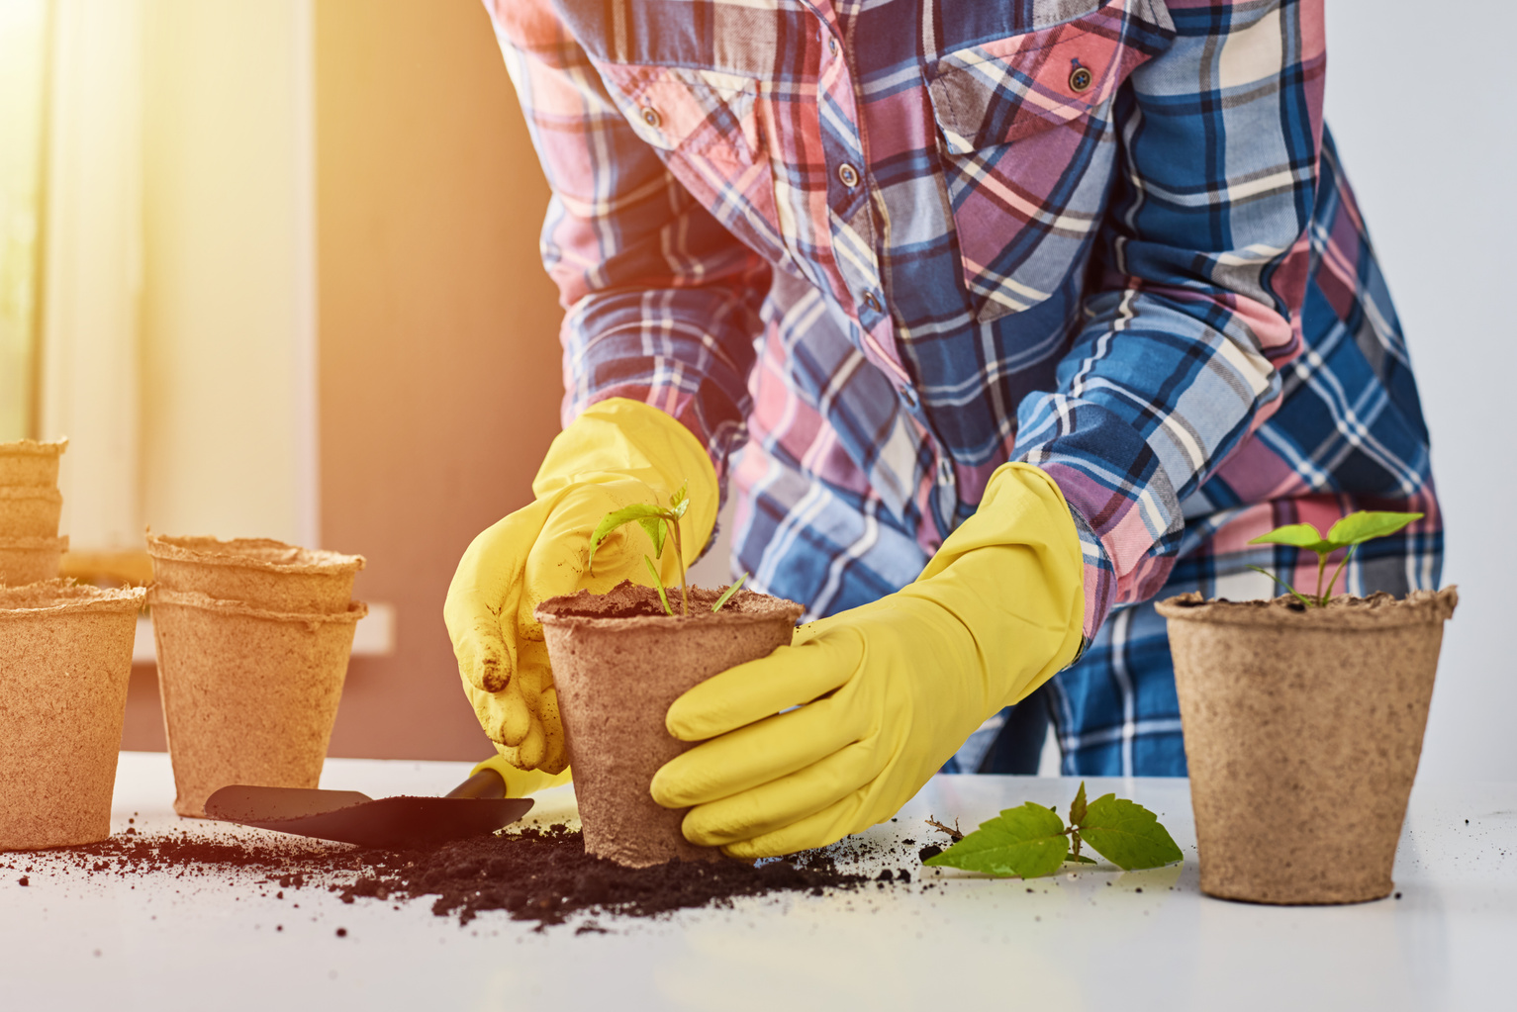
revenue model
Revenue Streams
- Product Sales: Green Thumb Kits ($99 physical, $49 digital)
- Subscription Service: Monthly seed delivery ($29/month) & annual gardening guidance ($99/year)
- Workshops & Webinars: In-person ($50-$100) & online ($20-$50)
- Affiliate Marketing: 10%-20% commission on sales
- Advertising: Targeted online ads
Revenue Projections
- Year 1: $500,000 (product sales), $200,000 (subscription)
- Year 2: $1,500,000 (product sales), $500,000 (subscription)
- Year 3: $3,000,000 (product sales), $1,000,000 (subscription)

Slide 8

THANK YOU

